Slide 1
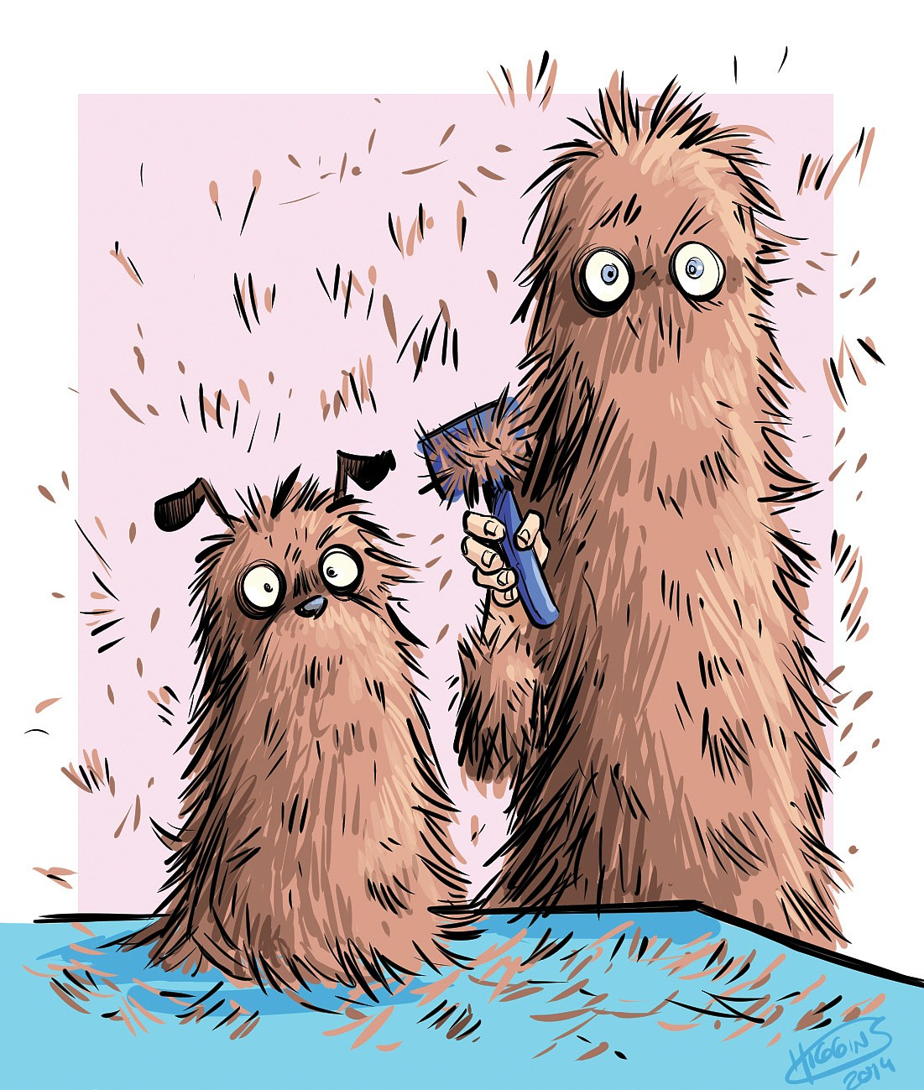
Deshedding package
Goose and Lettuce Dog Salon🐾
May 21, 2014 by RHONDA OWEN SPECIAL TO THE DEMOCRAT-GAZETTE

Slide 2
Why dogs shed
The main purpose of dogs shedding their coat is to make way for their new coat. This is to help with thermoregulation – maintaining their body temperature.
Helps remove hair that’s damaged to replace with new healthy hairs
Due to central heating, dogs can shed all year round instead of seasonally

Slide 3
Why help the process?
Help to keep your dog cool in summer and warm in winter
Prevents matting
Helps to identify parasites
Prevents skin issues

Slide 4
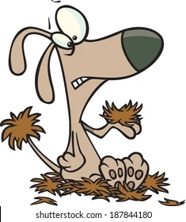
Matting and compaction
Hair gets tangled and wraps around itself forming a tight lump of fur that pulls the skin. If not addressed, it will tangle up with more hair oil and dirt becoming bigger and more painful
Compactions happen when the hair builds up and becomes stuck under the mats, often the undercoat becoming trapped and dense between the skin and topcoat.
Causes pain and prevents thermoregulation through stopping air flow.

Slide 5
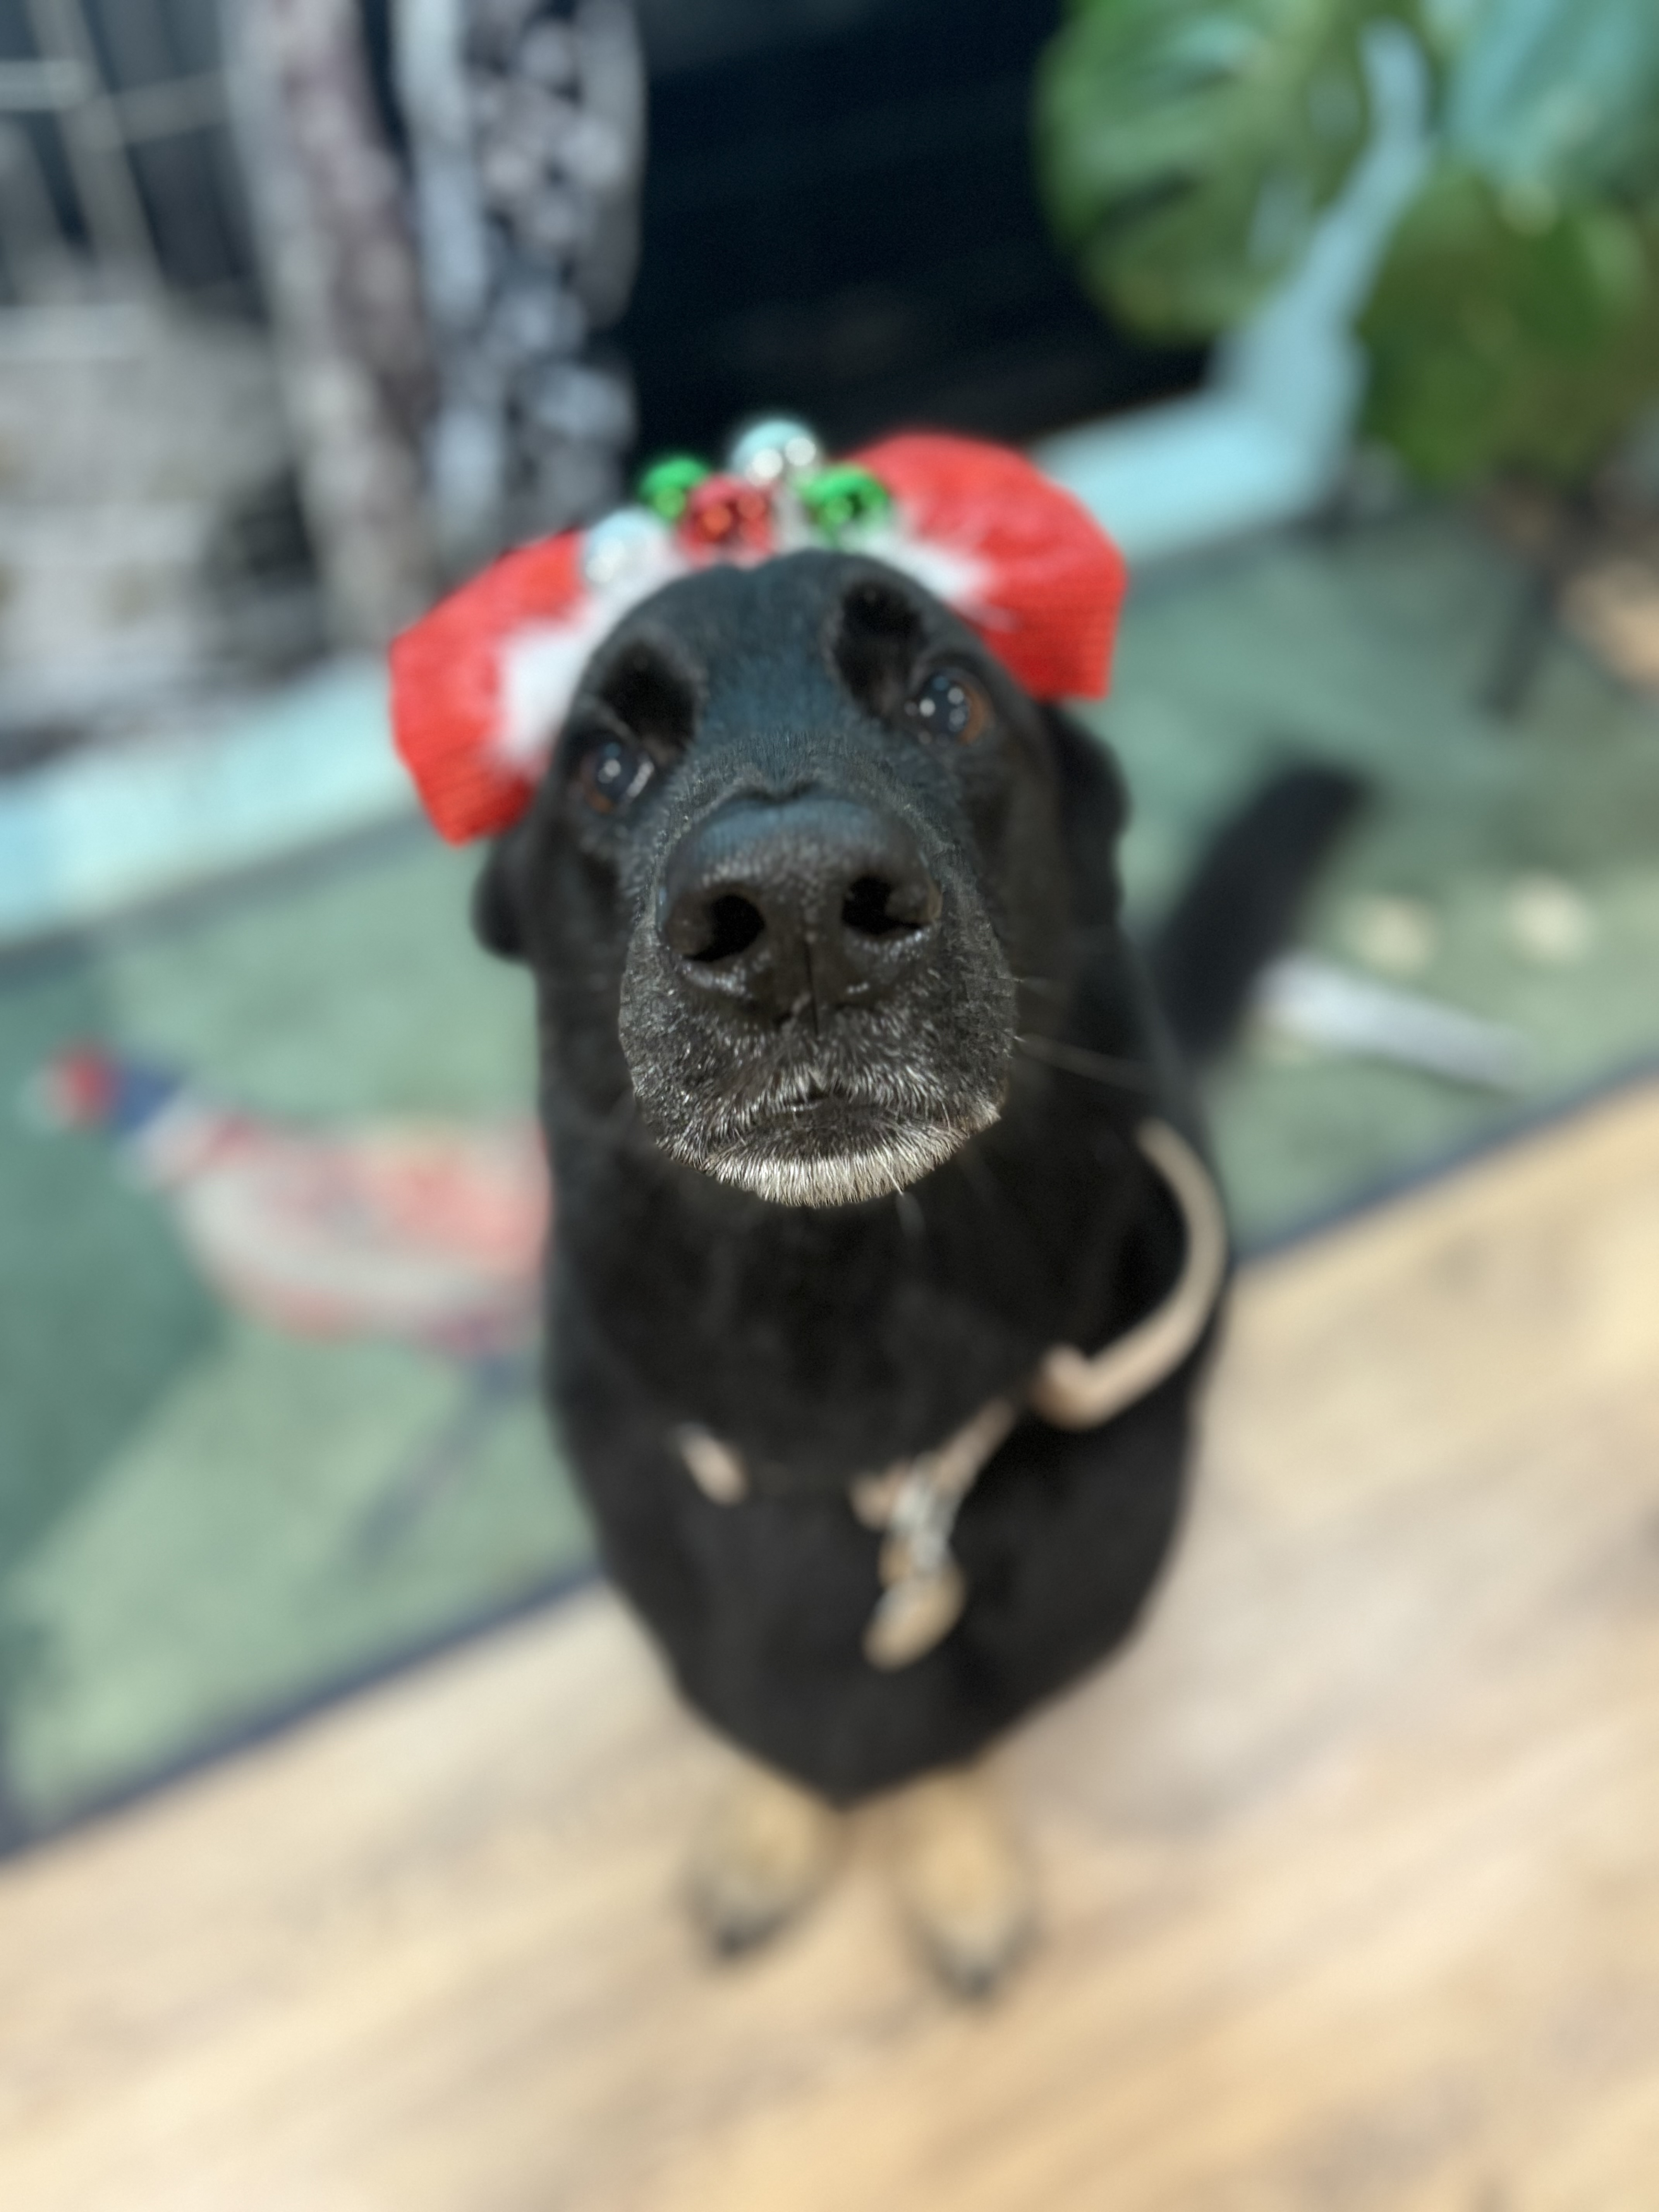
How does a deshed help
When mats occur, under the animal welfare act 2006 groomers are only able to brush out matted hair for 10 minutes before it is classed as cruelty. So, these mats then must be clipped out.
Clipping a double coat is also bad for the dog but the lesser of two evils as it damages the coat further and prevents thermoregulation
De-shedding prevents compactions and matting so clipping will not have to become an option

Slide 6
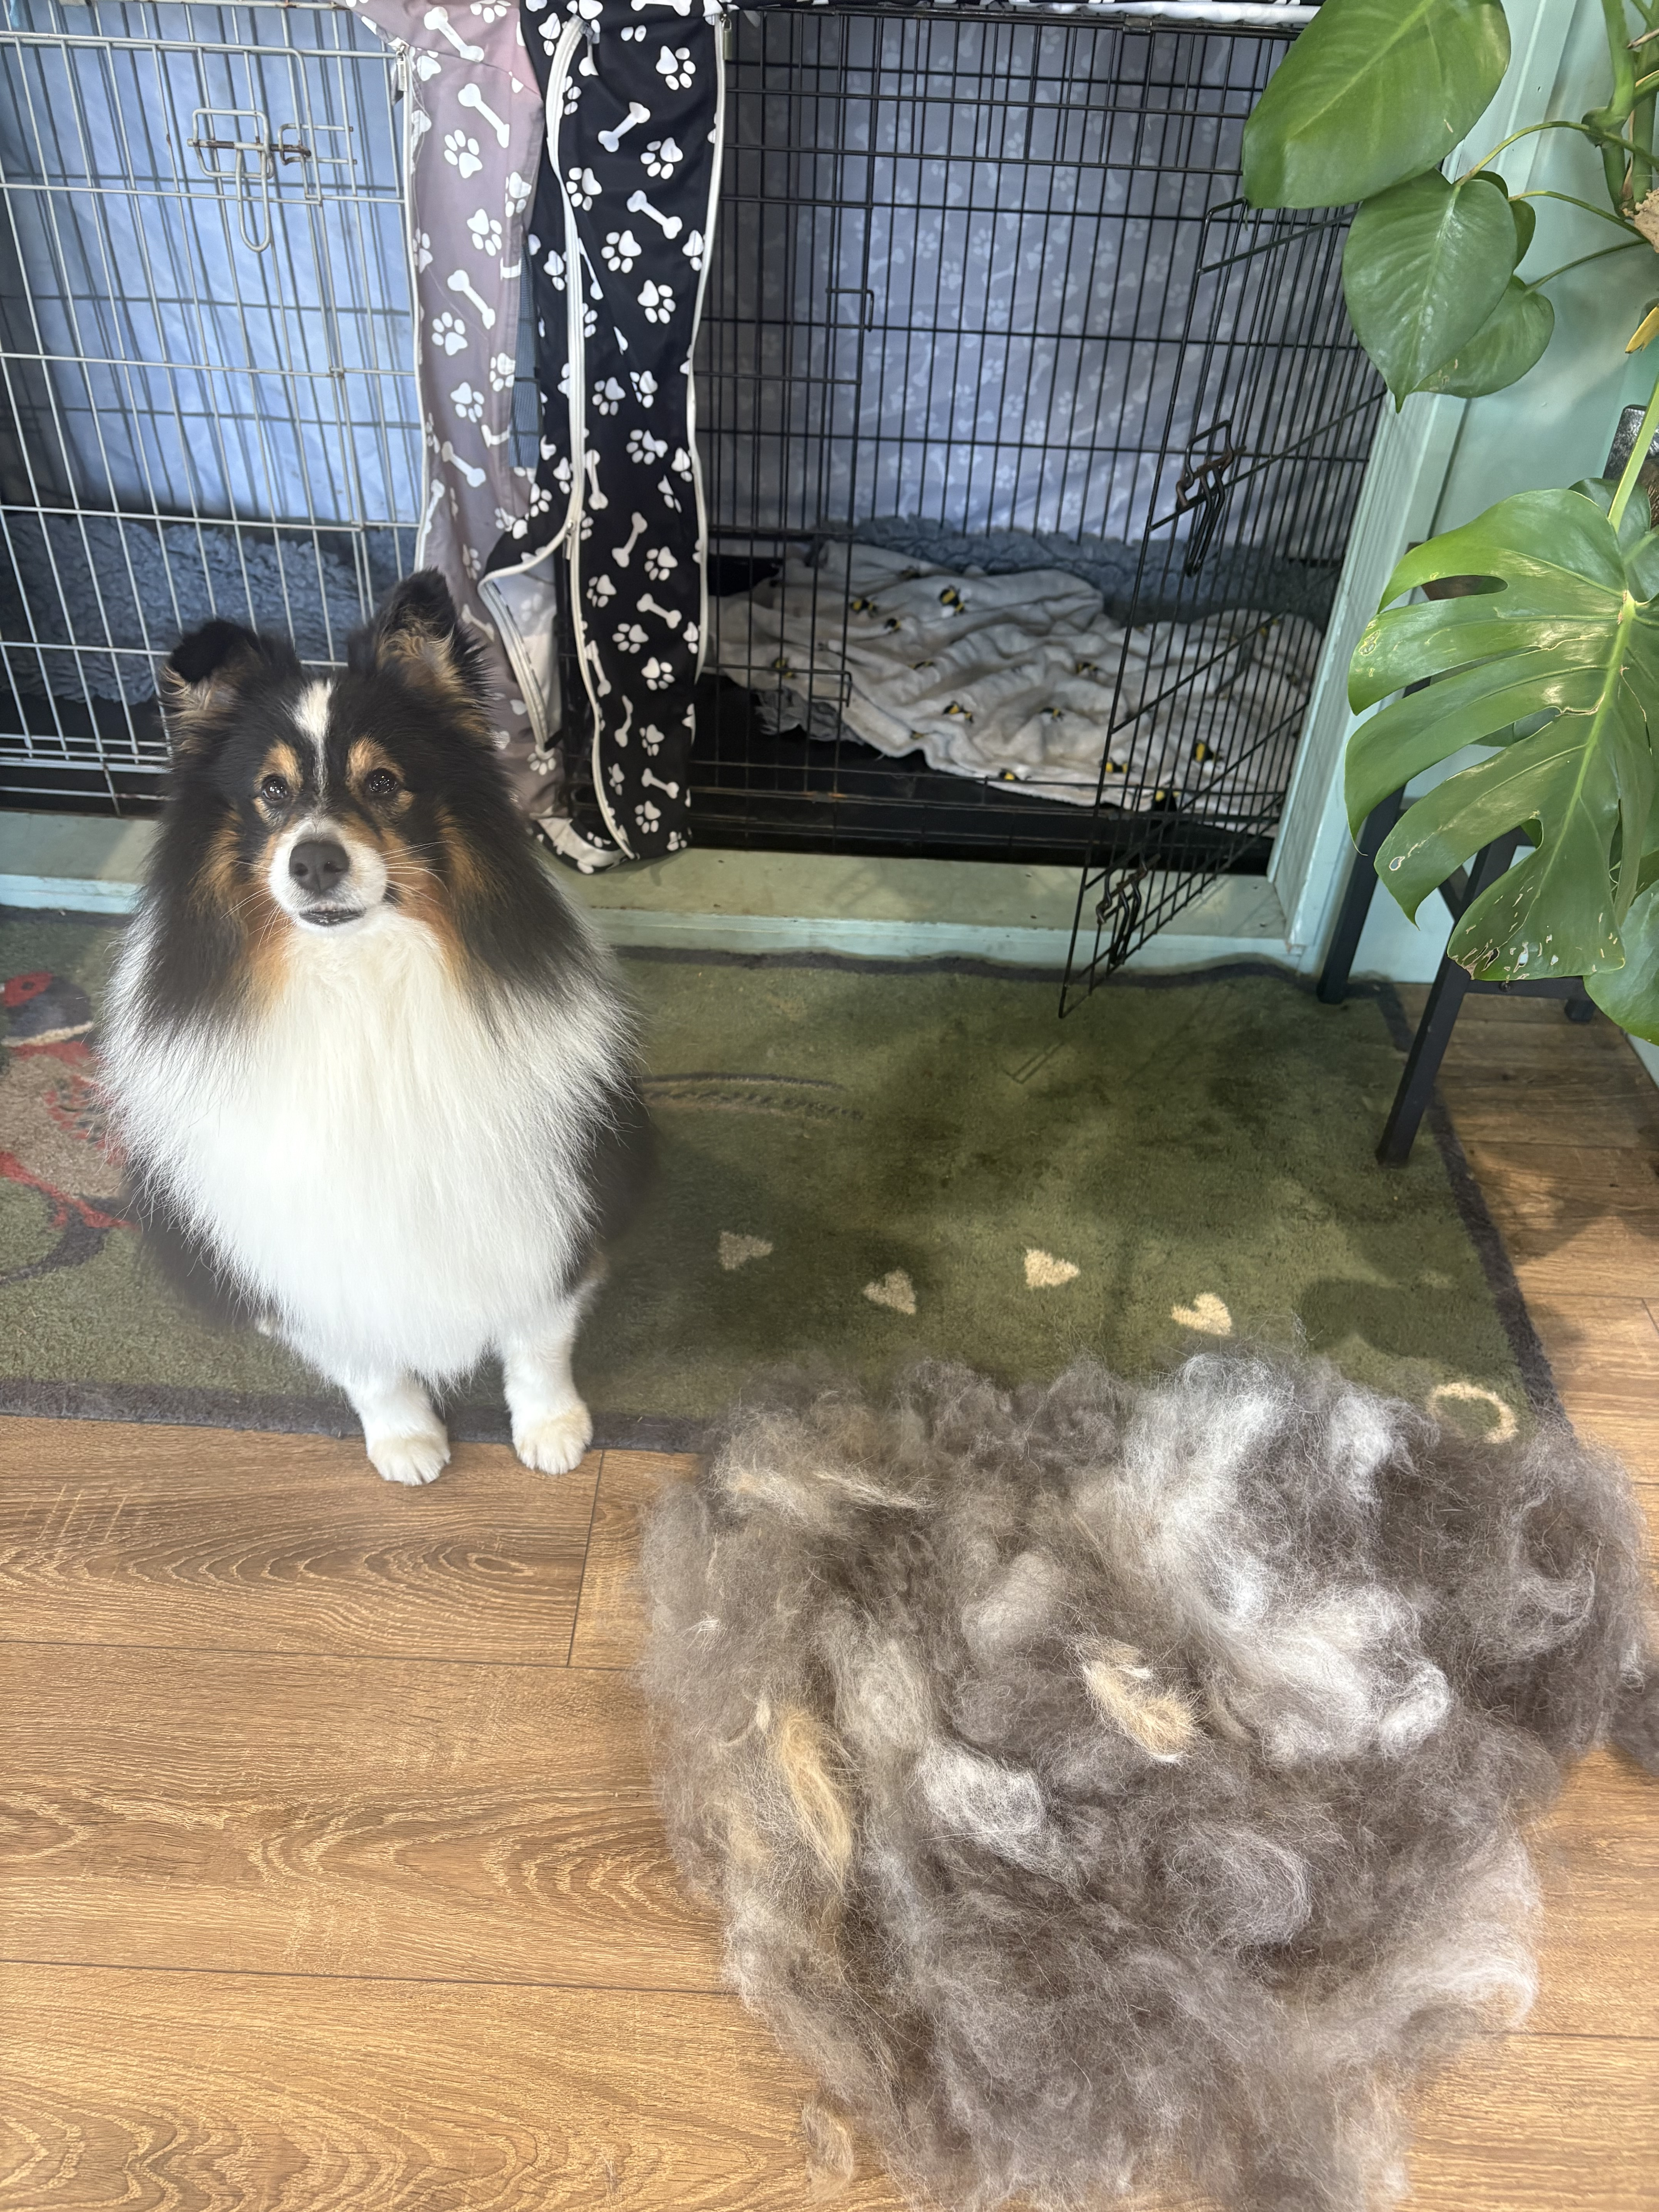

The Goose and Lettuce de-shedding package
Full brush out to remove dirt followed by a coat specific de-shedding brush to remove blown out coat
Pre bath blow out to further remove hair
Deshedding clay to help remove dead hair and nourish the skin with natural minerals
Deshedding shampoo deep cleans and nourishes the skin whilst helping remove the hair in the shower. Full brush and scrub in the shower to help remove dead coat
Conditioner for shine and nourishment
Full blast dry, conditioning spray and brush out
Shedding spray to help target the hair that coming out at home
A trim to suit the breed and lifestyle

Slide 7
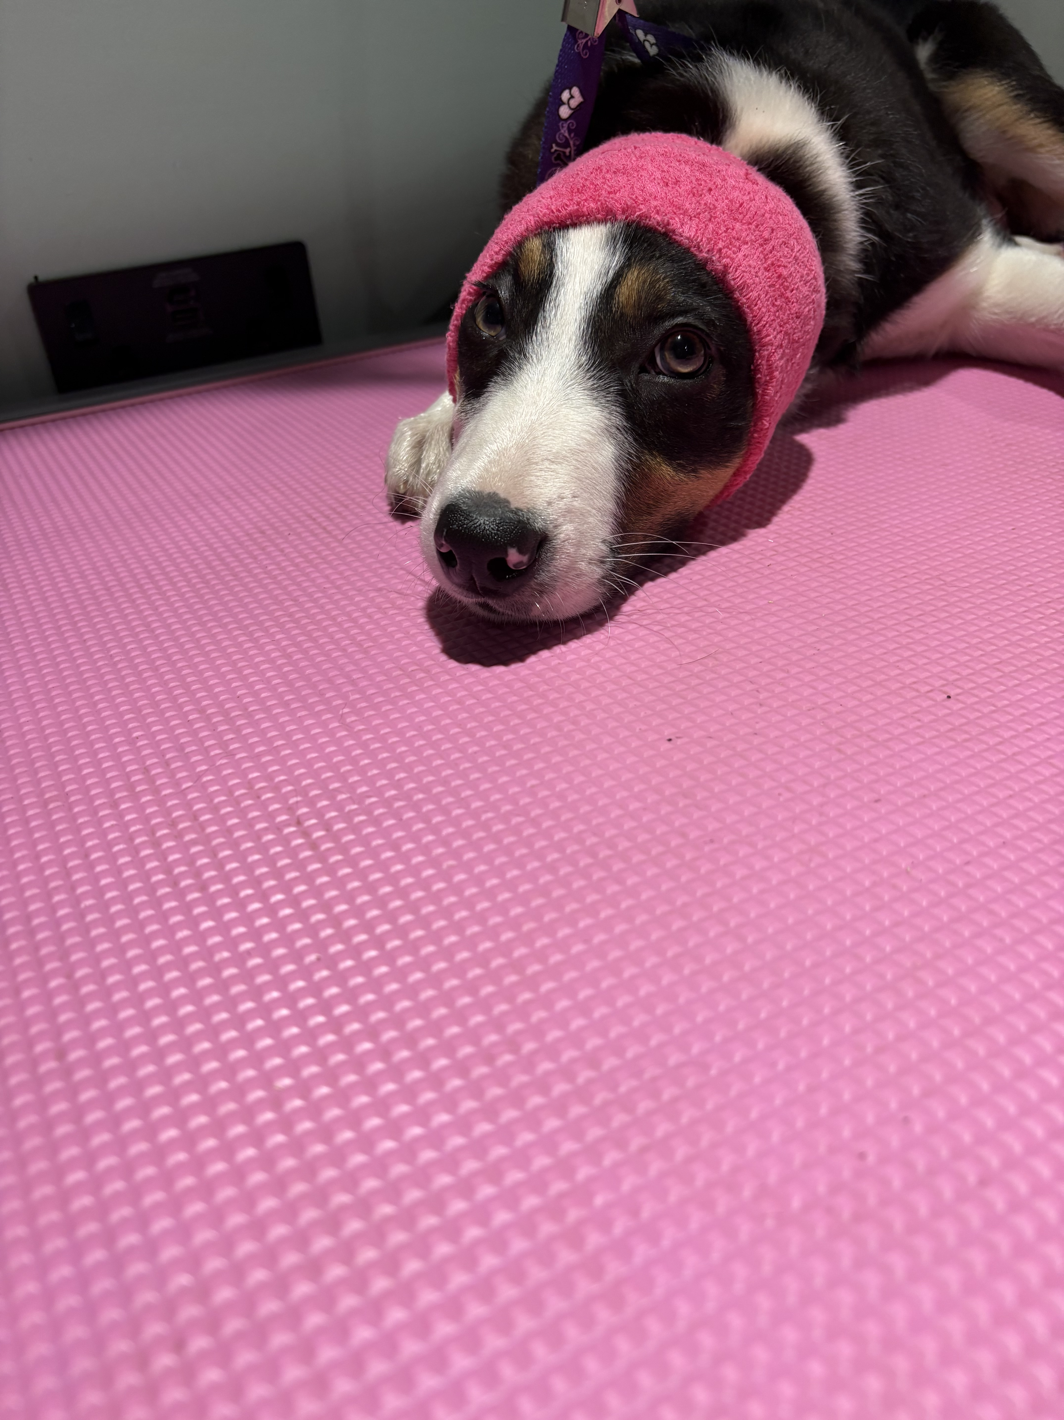
Pricing
Small dog: £40
Medium dog £45
Large: £50
Extra large: £55

Slide 8
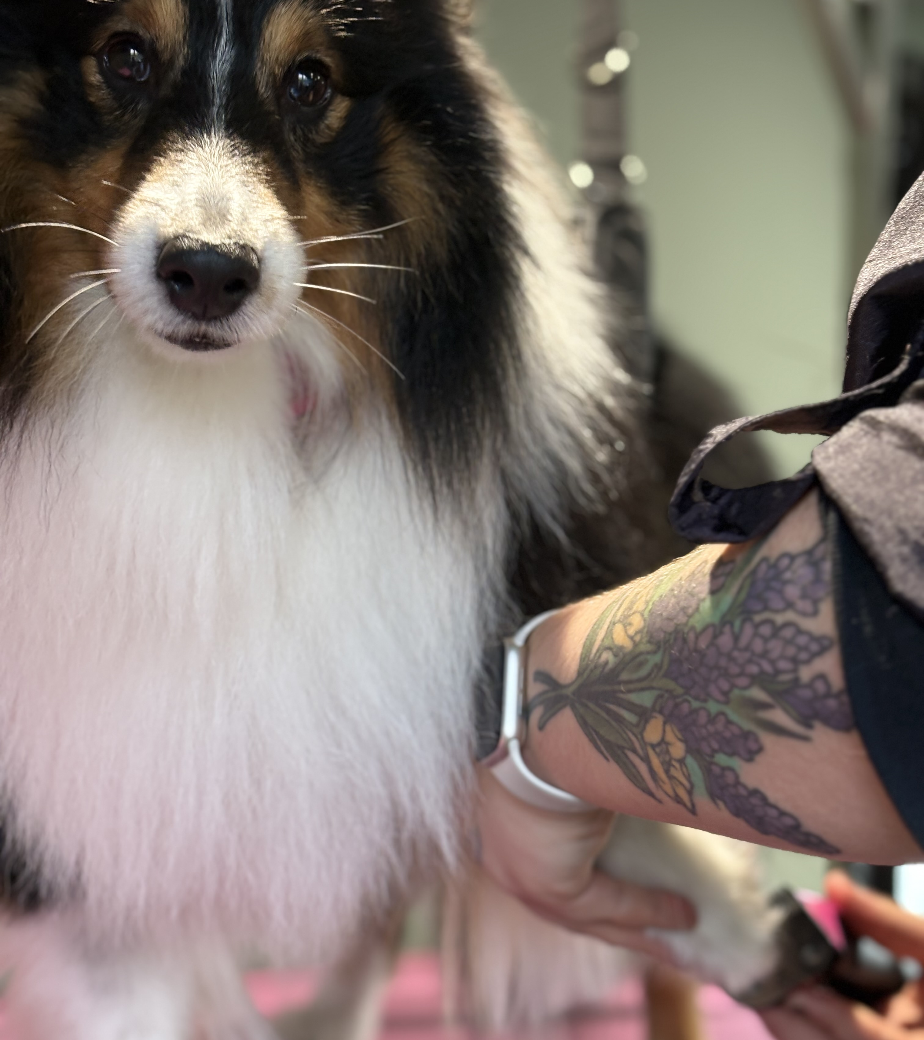
Why is it more than a full groom
Full grooms include a brush, bath, dry and style and this time frame is often not the best suit for our big fluffy dogs as they need more brushing out and different products to help get right down into the skin
More manual labor is needed for these grooms and more specialist products to help nourish the skin under the coat hence, it is reflected in the price

Slide 9
Questions and Answers
“Will I need a deshed every time I come in?”
-Not necessarily, for some dogs this may be the case, however some dogs may benefit from having a de-shed every other time they come in with a brush bath and tidy in between
“Why isn’t it just classed as a full groom”
-When a double coated dog comes in for either a brush, bath and tidy or a full groom, we do still brush them out as much as we possibly can as that is the right way to groom those breeds. However, the specialist products are better for coat management at home and in between grooms so are classified into a different package as more goes into them
“How often should my dog be groomed?"
-We suggest anywhere between 6-12 weeks depending on the coat length and management at home. But will always go through with you in our consultation

